Slide 1
Chapter 12: File System Implementation

Slide 2
Chapter 12: File System Implementation
File-System Structure
File-System Implementation
Directory Implementation
Allocation Methods
Free-Space Management

Slide 3
Objectives
To describe the details of implementing local file systems and directory structures
To describe the implementation of remote file systems
To discuss block allocation and free-block algorithms and trade-offs

Slide 4
File-System Structure
File structure
  Logical storage unit
  Collection of related information
File system resides on secondary storage (disks)
  Provided user interface to storage, mapping logical to physical
  Provides efficient and convenient access to disk by allowing data to be stored, located retrieved easily
Disk provides in-place rewrite and random access
  I/O transfers performed in blocks of sectors (usually 512 bytes)
File control block – storage structure consisting of information about a file
Device driver controls the physical device
File system organized into layers

Slide 5

Layered File System

Slide 6
File System Layers
Device drivers manage I/O devices at the I/O control layer
  Given commands like “read drive1, cylinder 72, track 2, sector 10, into memory location 1060” outputs low-level hardware specific commands to hardware controller
Basic file system given command like “retrieve block 123” translates to device driver
Also manages memory buffers and caches (allocation, freeing, replacement)
  Buffers hold data in transit
  Caches hold frequently used data
File organization module understands files, logical address, and physical blocks
  Translates logical block # to physical block #
  Manages free space, disk allocation

Slide 7
File System Layers (Cont.)
Logical file system manages metadata information
  Translates file name into file number, file handle, location by maintaining file control blocks (inodes in UNIX)
  Directory management
  Protection
Layering useful for reducing complexity and redundancy, but adds overhead and can decrease performanceTranslates file name into file number, file handle, location by maintaining file control blocks (inodes in UNIX)
  Logical layers can be implemented by any coding method according to OS designer

Slide 8
File System Layers (Cont.)
Many file systems, sometimes many within an operating system
  Each with its own format (CD-ROM is ISO 9660; Unix has UFS, FFS; Windows has FAT, FAT32, NTFS as well as floppy, CD, DVD Blu-ray, Linux has more than 40 types, with extended file system ext2 and ext3 leading; plus distributed file systems, etc.)
  New ones still arriving – ZFS, GoogleFS, Oracle ASM, FUSE

Slide 9
File-System Implementation
We have system calls at the API level, but how do we implement their functions?
  On-disk and in-memory structures
Boot control block contains info needed by system to boot OS from that volume
  Needed if volume contains OS, usually first block of volume
Volume control block (superblock, master file table) contains volume details
  Total # of blocks, # of free blocks, block size, free block pointers or array
Directory structure organizes the files
  Names and inode numbers, master file table

Slide 10

File-System Implementation (Cont.)
Per-file File Control Block (FCB) contains many details about the file
  inode number, permissions, size, dates
  NFTS stores into in master file table using relational DB structures

Slide 11
In-Memory File System Structures
Mount table storing file system mounts, mount points, file system types
The following figure illustrates the necessary file system structures provided by the operating systems
Figure 12-3(a) refers to opening a file
Figure 12-3(b) refers to reading a file
Plus buffers hold data blocks from secondary storage
Open returns a file handle for subsequent use
Data from read eventually copied to specified user process memory address

Slide 12

In-Memory File System Structures

Slide 13
Directory Implementation
Linear list of file names with pointer to the data blocks
  Simple to program
  Time-consuming to execute
    Linear search time
    Could keep ordered alphabetically via linked list or use B+ tree
Hash Table – linear list with hash data structure
  Decreases directory search time
  Collisions – situations where two file names hash to the same location
  Only good if entries are fixed size, or use chained-overflow method

Slide 14
Allocation Methods - Contiguous
An allocation method refers to how disk blocks are allocated for files:
Contiguous allocation – each file occupies set of contiguous blocks
  Best performance in most cases
  Simple – only starting location (block #) and length (number of blocks) are required
  Problems include finding space for file, knowing file size, external fragmentation, need for compaction off-line (downtime) or on-line

Slide 15

Contiguous Allocation
Mapping from logical to physical
Q
LA/512
R
  Block to be accessed = Q + starting address
  Displacement into block = R

Slide 16
Extent-Based Systems
Many newer file systems (i.e., Veritas File System) use a modified contiguous allocation scheme
Extent-based file systems allocate disk blocks in extents
An extent is a contiguous block of disks
  Extents are allocated for file allocation
  A file consists of one or more extents

Slide 17
Allocation Methods - Linked
Linked allocation – each file a linked list of blocks
  File ends at nil pointer
  No external fragmentation
  Each block contains pointer to next block
  No compaction, external fragmentation
  Free space management system called when new block needed
  Improve efficiency by clustering blocks into groups but increases internal fragmentation
  Reliability can be a problem
  Locating a block can take many I/Os and disk seeks

Slide 18
Allocation Methods – Linked (Cont.)
FAT (File Allocation Table) variation
  Beginning of volume has table, indexed by block number
  Much like a linked list, but faster on disk and cacheable
  New block allocation simple

Slide 19
Linked Allocation
Each file is a linked list of disk blocks: blocks may be scattered anywhere on the disk
block =
pointer
Mapping
Q
LA/511
R
  Block to be accessed is the Qth block in the linked chain of blocks representing the file.
  Displacement into block = R + 1

Slide 20

Linked Allocation

Slide 21

File-Allocation Table

Slide 22
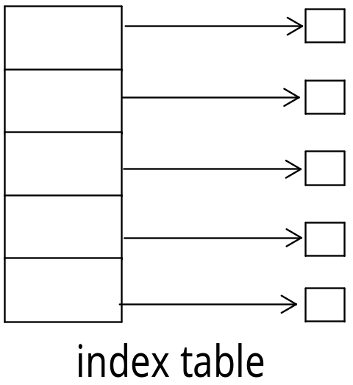
Allocation Methods - Indexed
Indexed allocation
  Each file has its own index block(s) of pointers to its data blocks
Logical view

Slide 23

Example of Indexed Allocation

Slide 24
Indexed Allocation (Cont.)
Need index table
Random access
Dynamic access without external fragmentation, but have overhead of index block
Mapping from logical to physical in a file of maximum size of 256K bytes and block size of 512 bytes. We need only 1 block for index table
Q
LA/512
R
Q = displacement into index table
R = displacement into block

Slide 25
Indexed Allocation – Mapping (Cont.)
Mapping from logical to physical in a file of unbounded length (block size of 512 words)
Linked scheme – Link blocks of index table (no limit on size)
Q₁
LA / (512 x 511)
R₁
  Q₁ = block of index table
  R₁ is used as follows:
Q₂
R₁ / 512
R₂
  Q₂ = displacement into block of index table
  R₂ displacement into block of file:

Slide 26
Indexed Allocation – Mapping (Cont.)
Two-level index (4K blocks could store 1,024 four-byte pointers in outer index -> 1,048,567 data blocks and file size of up to 4GB)
Q₁
LA / (512 x 512)
R₁
  Q₁ = displacement into outer-index
  R₁ is used as follows:
Q₂
R₁ / 512
R₂
  Q₂ = displacement into block of index table
  R₂ displacement into block of file:

Slide 27
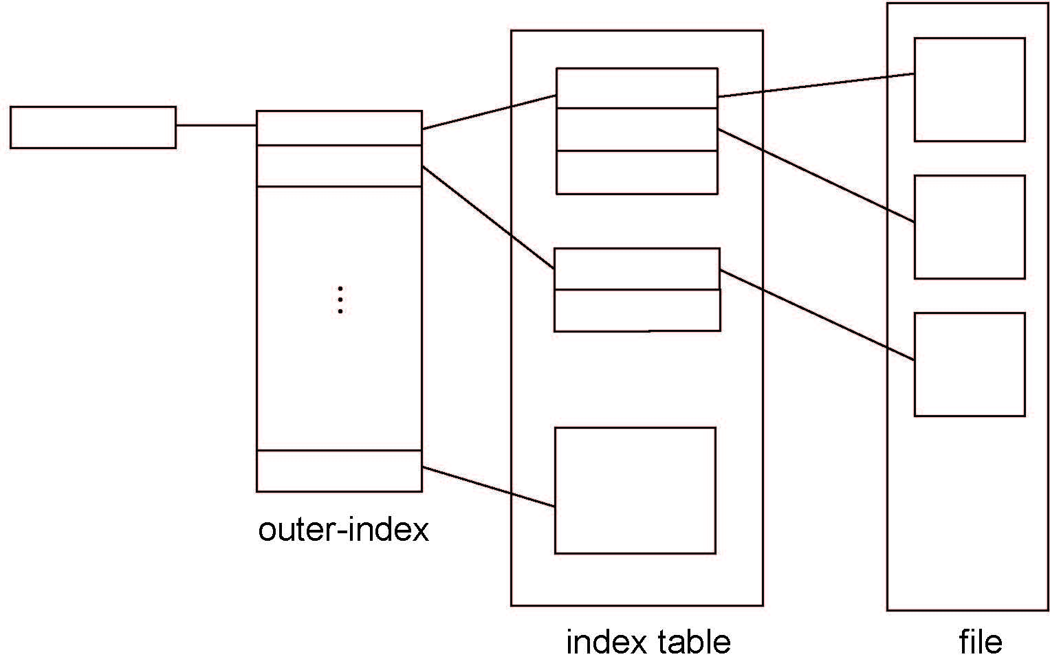
Indexed Allocation – Mapping (Cont.)

Slide 28

Combined Scheme: UNIX UFS
4K bytes per block, 32-bit addresses
More index blocks than can be addressed with 32-bit file pointer

Slide 29
Performance
Best method depends on file access type
  Contiguous great for sequential and random
Linked good for sequential, not random
Declare access type at creation -> select either contiguous or linked
Indexed more complex
  Single block access could require 2 index block reads then data block read
  Clustering can help improve throughput, reduce CPU overhead

Slide 30
Performance (Cont.)
Adding instructions to the execution path to save one disk I/O is reasonable
  Intel Core i7 Extreme Edition 990x (2011) at 3.46Ghz = 159,000 MIPS
    http://en.wikipedia.org/wiki/Instructions_per_second
  Typical disk drive at 250 I/Os per second
    159,000 MIPS / 250 = 630 million instructions during one disk I/O
  Fast SSD drives provide 60,000 IOPS
    159,000 MIPS / 60,000 = 2.65 millions instructions during one disk I/O

Slide 31
Free-Space Management
File system maintains free-space list to track available blocks/clusters
  (Using term “block” for simplicity)
Bit vector or bit map (n blocks)
0
1
2
n-1
…
1 ⇒ block[i] free
0 ⇒ block[i] occupied
bit[i] =

Block number calculation
(number of bits per word) *
(number of 0-value words) +
offset of first 1 bit
CPUs have instructions to return offset within word of first “1” bit

Slide 32
Free-Space Management (Cont.)
Bit map requires extra space
  Example:
block size = 4KB = 2¹² bytes
disk size = 2⁴⁰ bytes (1 terabyte)
n = 2⁴⁰/2¹² = 2²⁸ bits (or 32MB)
if clusters of 4 blocks -> 8MB of memory
Easy to get contiguous files

Slide 33

Linked Free Space List on Disk
Linked list (free list)
  Cannot get contiguous space easily
  No waste of space
  No need to traverse the entire list (if # free blocks recorded)

Slide 34
Free-Space Management (Cont.)
Grouping
  Modify linked list to store address of next n-1 free blocks in first free block, plus a pointer to next block that contains free-block-pointers (like this one)
Counting
  Because space is frequently contiguously used and freed, with contiguous-allocation allocation, extents, or clustering
    Keep address of first free block and count of following free blocks
    Free space list then has entries containing addresses and counts

